Slide 1

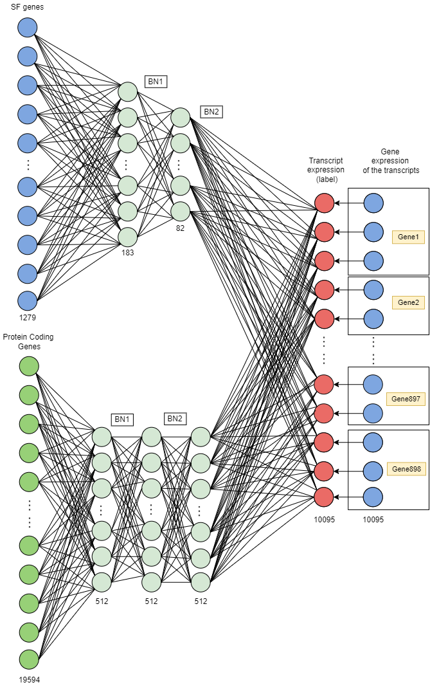
DeepSF: A Novel Deep Neural Network to Unveil Tumor Transcriptome
Master in Biomedical Engineering
Presented by
Joseba Sancho Zamora
Under the supervision of
Dr. Fernando Carazo

Slide 2
Table of contents
1
2
3
4
Theoretical Background
Goals
State of the art
Matherials and Methods
Optimizers
Workflow
3.1
4.1
5
6
Weight and Bias
Raw Data Processing
3.2
4.2
Modelling + Results
4.3
Conclusions
Future Lines

Slide 3


1. THEORETICAL BACKGROUND

Slide 4
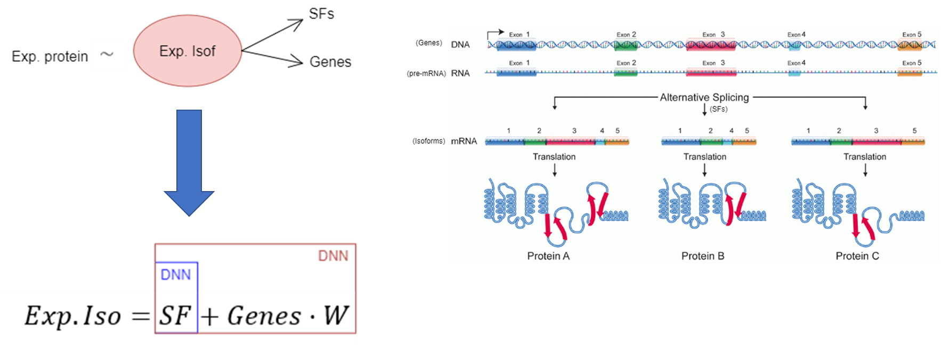
THEORETICAL BACKGROUND

Slide 5
2. GOALS

Slide 6
GOALS
Develop a DNN model capable of predicting transcript expression from the gene expression of SFs from different patient tumor tissues.
Application: Interpretation of the DNN model parameters to identify which splicing factors regulate which genes.

Slide 7
3. STATE OF THE ART
Optimizers
Weight and biases

Slide 8

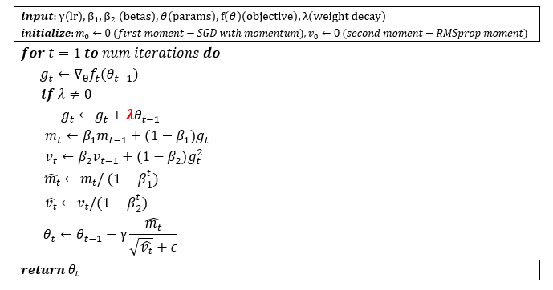
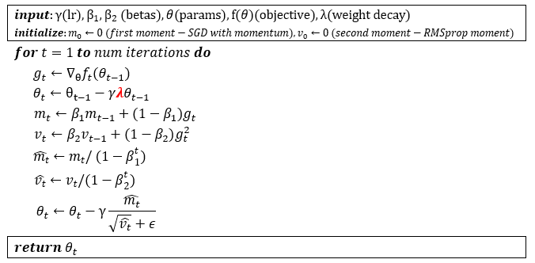
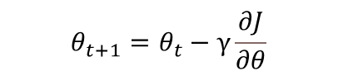
Optimizers
Algorithms used to minimize the loss function by updating the model parameters.
Stochastic Gradient Descent:
$$θ_{t+1}=θ_{t}−γ\frac{∂J}{∂θ}$$
Adaptive Moment Estimation (Adam)
AdamW
Notes:
Adam -> Combines SGD with momentum, and RMSProp.
Momentum -> exponential weights average of the previous gradients (mean).
RMSprop -> exponential weighted average of the square of the gradients (uncentered variance). Adaptive scale of the learning rate. Adam is an adaptive learning rate method, which means, it computes individual learning rates for different parameters.
Imagen de [https://medium.com/data-science-group-iitr/loss-functions-and-optimization-algorithms-demystified-bb92daff331c]
The variables$\hat{{ m}_{t}}$ y $\hat{v_{t}}$ are calculated to speed up the process in the first few iterations.

Slide 9
3. STATE OF THE ART
Optimizers
Weight and biases

Slide 10
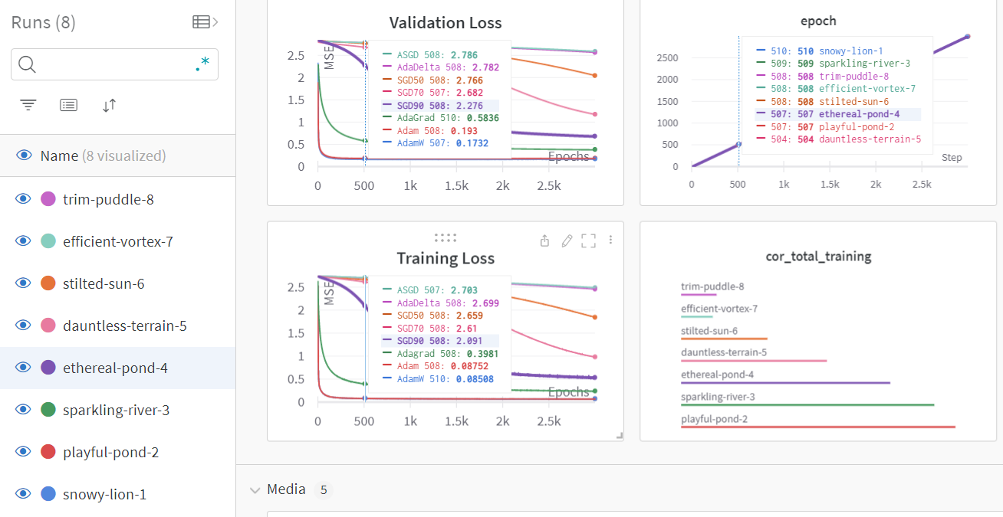
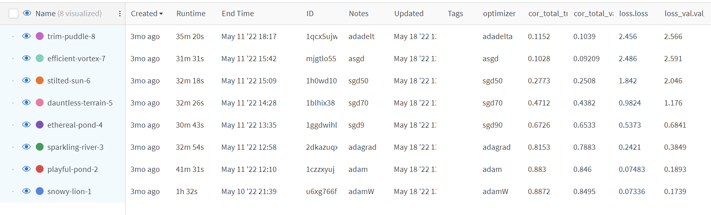
Weights and Biases
This platform has been used to track our experiments developed in Pytorch:
visualize interactively the training results (value of the metrics, artifacts and plots) as well as the running settings.
save versions of the models with their trained parameters,

Slide 11
4. MATHERIALS AND METHODS
Workflow
Raw Data Processing
Modeling + Results

Slide 12
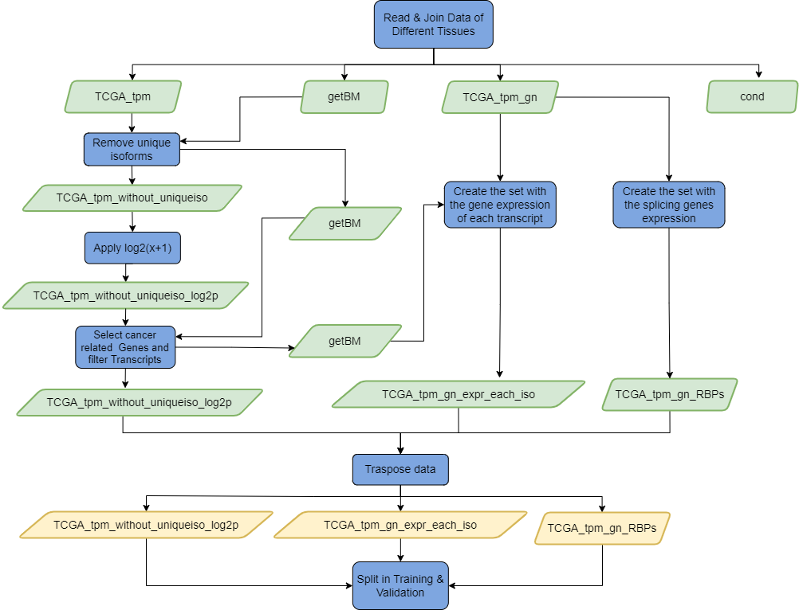
Raw Data processing Workflow
Notes:
OPCION 1 DE WORKFLOW

Slide 13
4. MATHERIALS AND METHODS
Workflow
Raw Data Processing
Modeling + Results

Slide 14
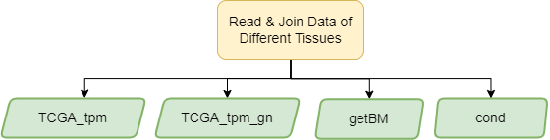
Raw Data Processing
Patient data was obtained from The Cancer Genome Atlas Program (TCGA)
Samples were parsed to calculate the gene expression.
As a result, we obtained these 4 raw data sets:
TCGA_tpm: contains the expression of 199,169 isoforms (in transcripts per million).
TCGA_tpm_gn: contains the expression of 60,554 genes in TPM.
getBM: relates each of the isoforms with its respective transcript and biotype.
Cond: indicates the condition of the patient for each sample.
Biotype | Number of isoforms
Protein coding | 79,930
Processed transcript | 26,977
Retained intron | 26,704
LincRNA | 13,481
Nonsense mediated decay | 13,409
Notes:
TCGA has molecularly characterized more tan 20,000 primary cancer samples from 33 tumor types.
Las muestras en formato tsv fueron parseados para calcular la expresión génica de todos ellos.
As can be seen in the last table, not all the transcriptome has a direct coding function. We can see, among others, a large number of processed transcripts that are genes or transcripts that do not have a sequence of bases through which the ribosome can travel and translate their information, read in codons (series of three bases), into amino acids to synthesize a protein.
Long non-coding RNA (lncRNA) are sequences of more than 200 bp that do not encode proteins. Within this group the retained introns can be described, which are transcripts that from an alternative splicing have introns (non-coding reads) of transcripts that are protein coding (Ensembl, s.f.).
In addition, the nonsense mediated decay are transcripts that are marked with a premature stop codon so that they can be eliminated by a RNA quality control mechanism so that these sequences do not end up being translated into proteins that can cause any pathology in the organism (Tatsuaki Kurosaki, 2016).

Slide 15
Raw Data Processing
Tissue | Condition | Number of samples | Total
Lung Adenocarcinoma (LUAD) | Tumor | 516 | 600
 | Normal | 59
 | Other | 25
Colon adenocarcinoma (COAD) | Tumor | 458 | 524
 | Normal | 41
 | Other | 25
Pancreatic adenocarcinoma (PAAD) | Tumor | 178 | 183
 | Normal | 4
 | Other | 1
Prostate adenocarcinoma (PRAD) | Tumor | 497 | 554
 | Normal | 52
 | Other | 5
Rectum adenocarcinoma (READ) | Tumor | 166 | 177
 | Normal | 10
 | Other | 1
Ovarian serous cystadenocarcinoma (OV) | Tumor | 422 | 430
 | Other | 8
Stomach adenocarcinoma (STAD) | Tumor | 416 | 453
 | Normal | 37
 |  |  | 2921
For model development lung adenocarcinoma (LUAD) samples were used.
The final model was trained from the following adenocarcinoma samples:

Slide 16
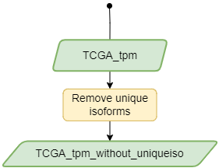
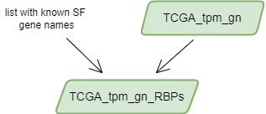
Removing unique isoforms and creating the set with the gene expression of the SFs
Raw Data Processing
199,169
Genes that have only one isoform are not of interest since alternative splicing will not occur in these cases.
The dataset with the expression of the SFs was generated from a list of 1279 known SFs and the dataset with the expression of all genes.
36,740
162,420
Notes:
For this reason, single transcripts were removed from the dataset with the expression of the transcripts.
A total of 36,740 transcripts were removed. This left a total of 162,420 transcripts.

Slide 17
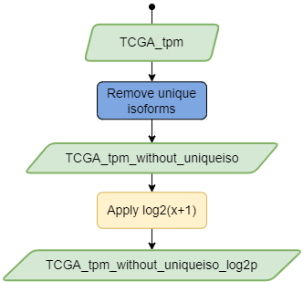
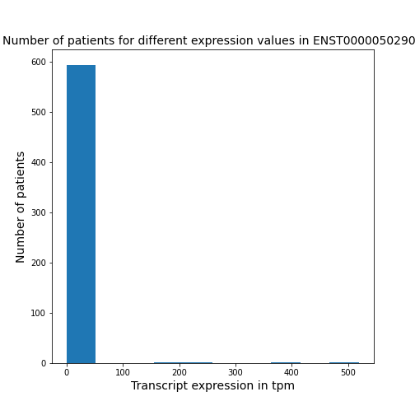
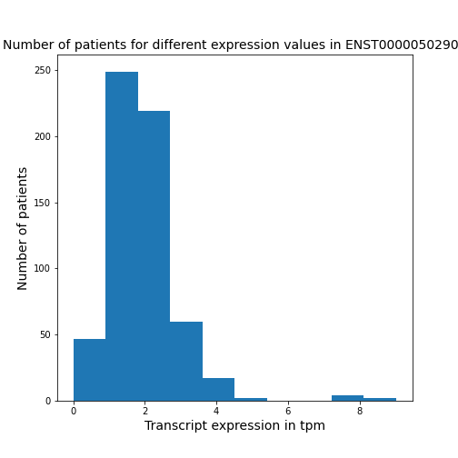

LOGARITHMIC TRANSFORMATION OF THE TRANSCRIPT EXPRESSION AND CREATE THE SET WITH THE GENE EXPRESSION FOR EACH ISOFORM
Raw Data Processing
Due to the large differences in the expression levels of the isoforms and the presence of outliers.
A new dataset was generated with the expression of the transcripts after applying the transformation.
$$\vec{z} = log2(\vec{x}+1)$$
Notes:
Where $\vec{x}$ is a vector with the original expression values of all patients for a transcript and $\vec{z}$ is the result of the logarithmic transformation for a given transcript.
This strategy was evaluated in the first steps of the model development.

Slide 18
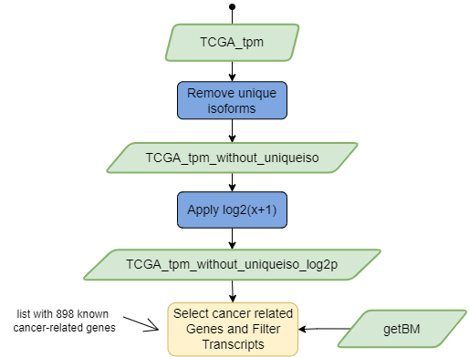
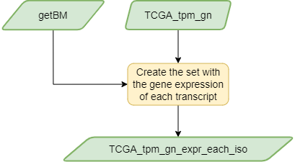
Select cancer related genes and filter the set of transcripts.
Raw Data Processing
10,095 transcripts were filtered.
Create the dataset with the gen expression of each transcript
A gene can belong to two or more transcripts.
Notes:
Aqui igual meter un ejemplo con los datasets y tal y que se vea que un gen puede tener mas de un transcrito. (HACER CUANDO ME ABURRA A LA NOCHE)

Slide 19
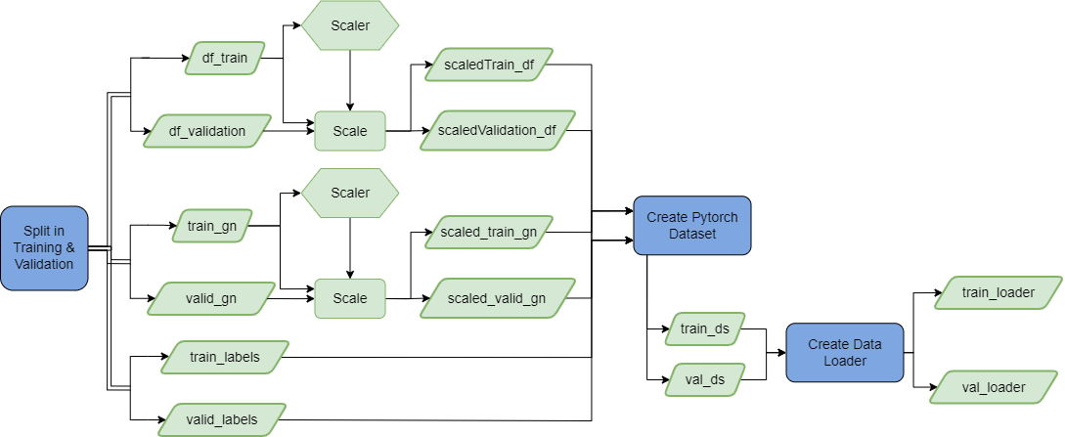
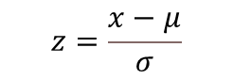
Dividing dataset in training & validation, scaling and data loader creation
Raw Data Processing
The datasets with the expression of SFs, genes and transcripts were transposed.
Datasets were randomly divided into 80% training and 20% validation.
Gene expression values vary considerably in magnitude and range, which can negatively affect model optimization.
With PyTorch models: data introduced in tensors, and two data loaders were created for batch training.
$$z=\frac{x−μ}{σ}$$
Notes:
This is a preprocessing method from the scikit-learn library that standardizes the features by eliminating their mean (thus ensuring that each of the features presents a Gaussian distribution with mean 0) and obtaining a standard deviation of 1. The formula used for calculating the Standard Scaler score of a sample is as follows:
Where $x$ is a sample and $μ$ and $σ$ are the mean and the standard deviation of the training samples. Therefore, for each feature, the mean and standard deviation was calculated fitting the training data into the scaler. These calculations are then used to, through a scalar transformation function, scale the training and validation data.
Aquí igual se podría poner un plot de antes y después del escalado.
Therefore, the dataset with the expression of SFs and genes for each transcript were scaled using the Standard Scale.

Slide 20
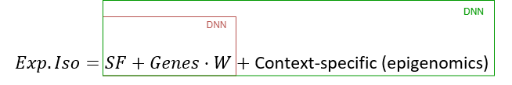
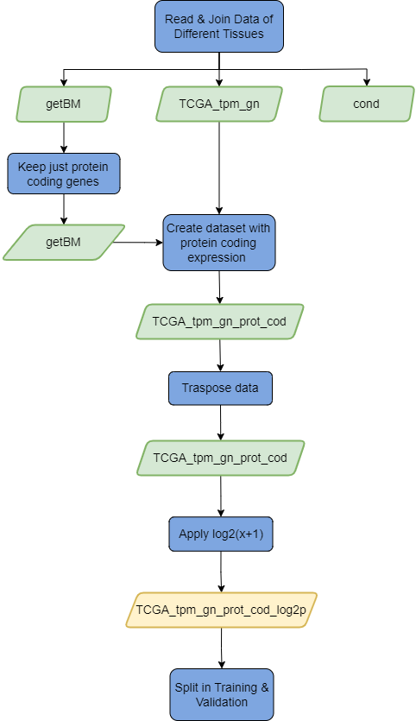
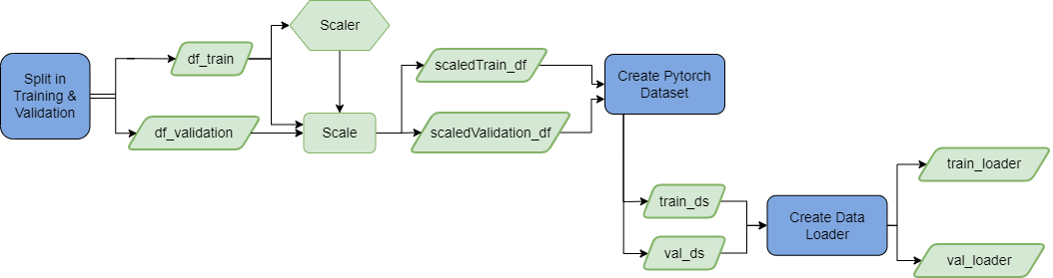
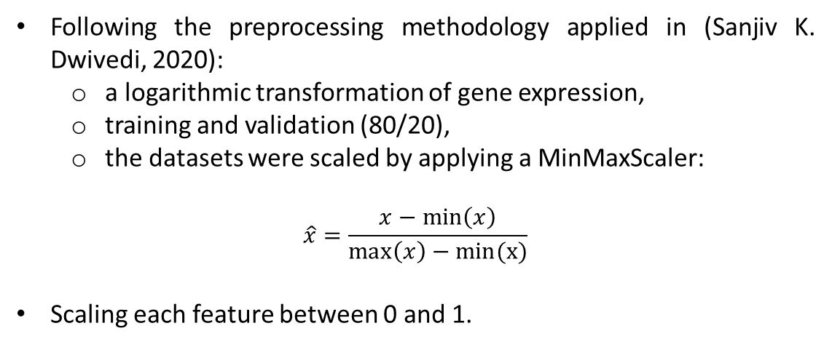
Data processing for the DeepAE
Following the preprocessing methodology applied in (Sanjiv K. Dwivedi, 2020):
a logarithmic transformation of gene expression,
training and validation (80/20),
the datasets were scaled by applying a MinMaxScaler:
$$\hat{x}=\frac{x−\min\left(x\right)}{\max\left(x\right)−min(x)}$$
Scaling each feature between 0 and 1.

Slide 21
4. MATHERIALS AND METHODS
Workflow
Raw Data Processing
Modelling + Results

Slide 22
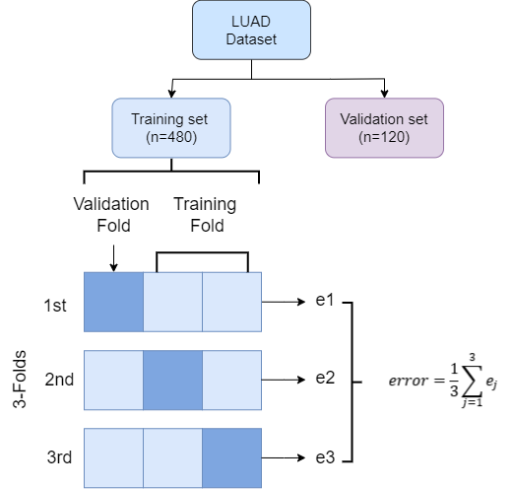
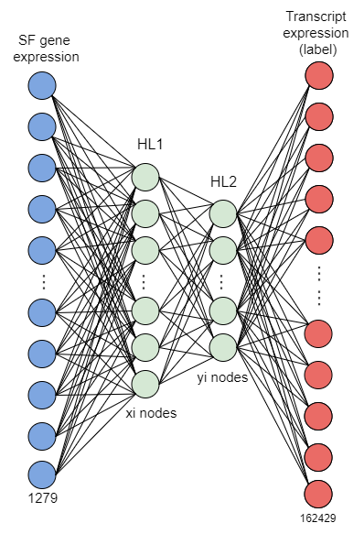
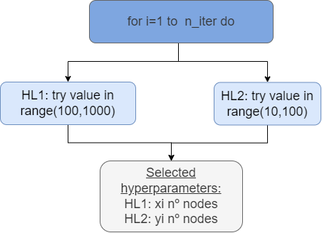
1) Optimization of the number of nodes with a 2 hidden layer model with keras
Development of the model DeepSF2hidden with gene expression
It was performed by means of a 3-fold Randomized Search CV.
Notes:
Mirar mi teoría del tfg para lo del cv y hacer en draw.io otro dibujo con 3k-fold

Slide 23
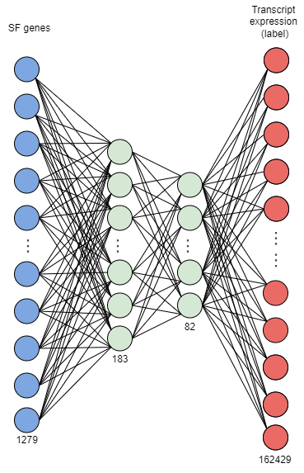
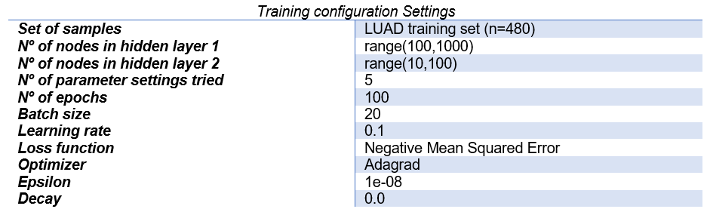
1) Optimization of the number of nodes with a 2 hidden layer model with keras
Development of the model DeepSF2hidden with gene expression
The experiment was repeated several times giving the following average results: 183 nodes for HL1 and 82 nodes for HL2.
The same number of nodes was always used for the model with 2 hidden layers.
Notes:
EXPLICAR BREVEMENTE QUE ES EL NEGATIVE MSE Y EL OPTIMIZADOR ADAGRAD UTILIZADO.
This means that a negative value is a prefix to all mse calculations.
Being the number of parameter settings tried the number of different combinations of HL1 and HL2 used from the specified distributions.

Slide 24
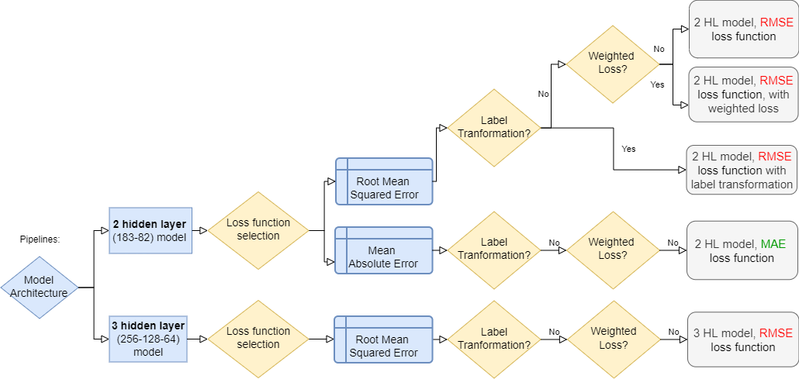
2) Selection of number of hidden layers, loss function and different strategies to counteract variability in isoform expression with Keras.
Development of the model DeepSF2hidden with gene expression

Slide 25
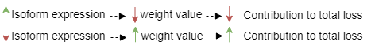
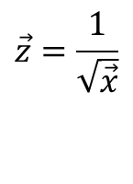
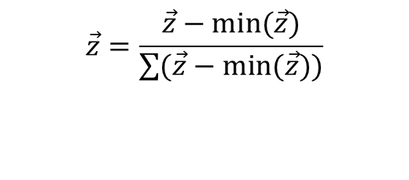
2) Selection of number of hidden layers, loss function and different strategies to counteract variability in isoform expression with Keras.
Development of the model DeepSF2hidden with gene expression
Implementation of a weighted loss
The mean of the expression values of the LUAD sample transcripts was calculated and the following function was applied:
Implementation of a transcript transformation function
The implementation of a logarithmic function in base 2 of the transcript expression was studied to counteract the presence of outliers.
$$\vec{z}=\frac{1}{\sqrt{\vec{x}}}$$
$$\vec{z}=\frac{\vec{z}−min(\vec{z})}{\sum{(\vec{z}}−min(\vec{z}))}$$
Notes:
The parameter loss weights when compiling the model was used to define the contribution of each of the transcript outputs to the total loss, i.e. to weight the losses of the model outputs.
the result was normalized so that the sum of all weights was equal to 1:

Slide 26
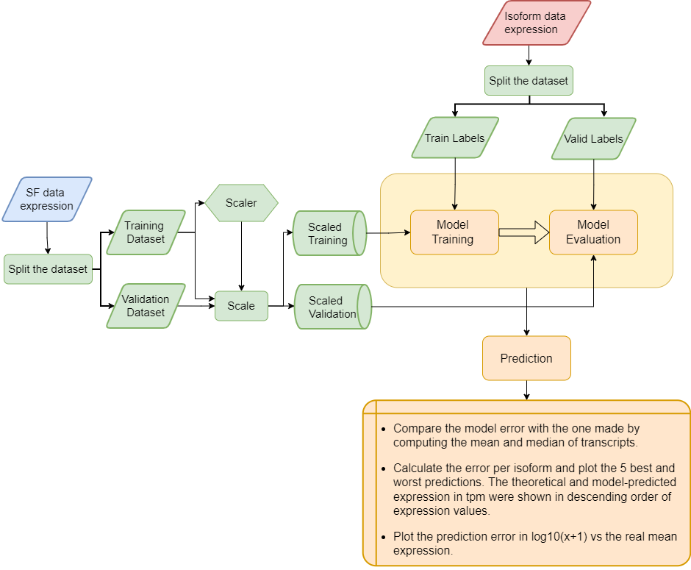
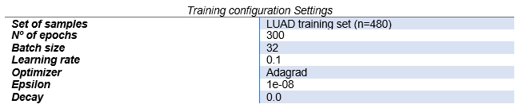
2) Selection of number of hidden layers, loss function and different strategies to counteract variability in isoform expression with Keras.
Development of the model DeepSF2hidden with gene expression
Training configuration:
The model performance was evaluated using the validations set.

Slide 27
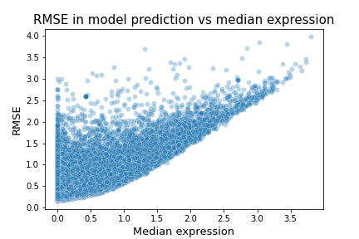

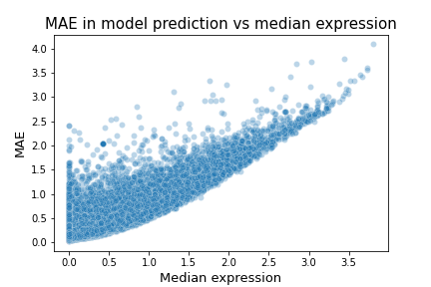
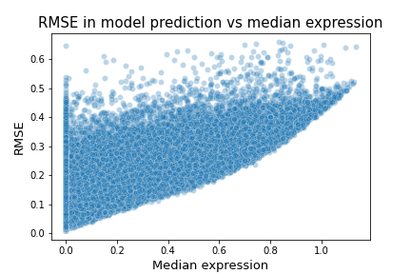
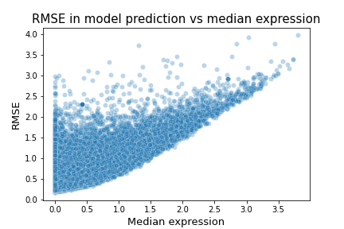
Development of the model DeepSF2hidden with gene expression
2) SELECT THE NUMBER OF HIDDEN LAYERS, THE LOSS FUNCTION AND TRYING DIFFERENT PIPELINES TO COUNTERACT VARIABILITY IN ISOFORM EXPRESSION.
Results
For all methodologies with RMSE and MAE loss functions, a higher mean expression of transcripts is associated with a higher error.
The model can not predict isoforms that low expression levels.
Only a log2 transformation of the isoform expression has reduced the effect of high expression outliers.
Model | RMSE values
2 HL with label transformation | 0.42
Mean imputation of the features with label transformation | 0.46
Median imputation of the features with label transformation | 0.48
2 HL model without label transformation but with weighted loss | 50.30
2 HL model without label transformation | 50.86
3 HL model without label transformation | 51.95
Mean imputation of features without label transformation | 116.76
Median imputation of features without label transformation | 120.72
Model error vs the error committed by using the mean and median of transcripts
2 HL model without label transformation
2 HL model without label transformation & weighted values
2 HL model without label transformation
2 HL model with label transformation
3HL model without label transformation

Slide 28
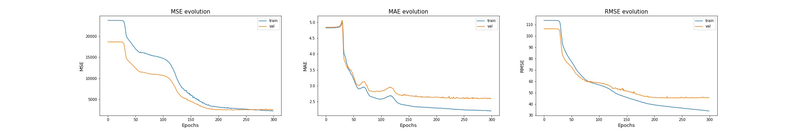
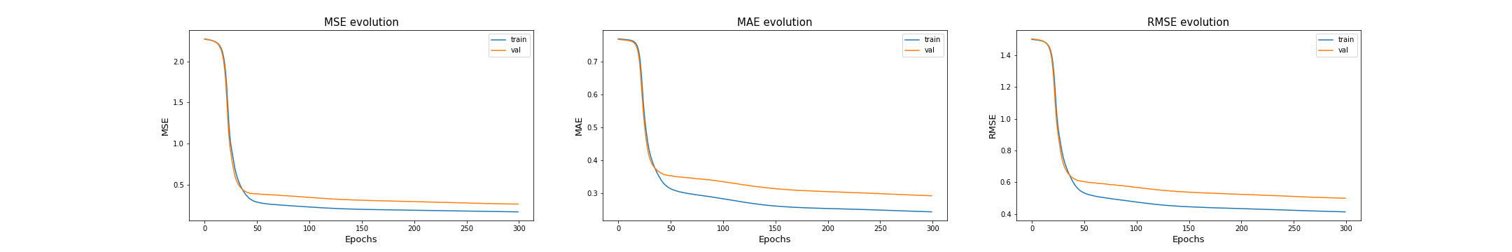
Development of the model DeepSF2hidden with gene expression
2) SELECT THE NUMBER OF HIDDEN LAYERS, THE LOSS FUNCTION AND TRYING DIFFERENT PIPELINES TO COUNTERACT VARIABILITY IN ISOFORM EXPRESSION.
Model | RMSE values
2 HL with label transformation | 0.42
Mean imputation of the features with label transformation | 0.46
Median imputation of the features with label transformation | 0.48
2 HL model without label transformation but with weighted loss | 50.30
2 HL model without label transformation | 50.86
3 HL model without label transformation | 51.95
Mean imputation of features without label transformation | 116.76
Median imputation of features without label transformation | 120.72
Results - Applying a Label Transformation
Model error was significantly reduced.
The learning curve became smoother, and the model reached convergence earlier.
Model error vs the error committed by using the mean and median of transcripts
2 HL model without label transformation
2 HL model with label transformation

Slide 29
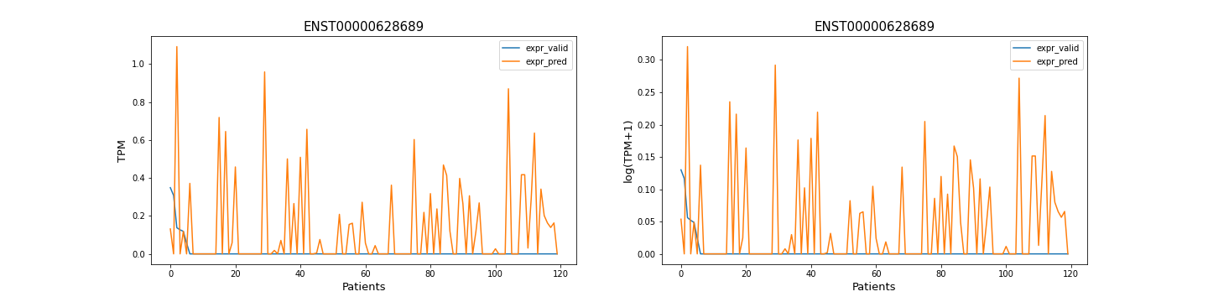
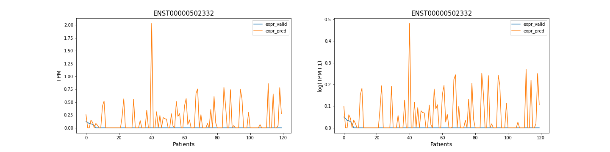
Development of DeepSF2hidden with gene expression
2) SELECT THE NUMBER OF HIDDEN LAYERS, THE LOSS FUNCTION AND TRYING DIFFERENT PIPELINES TO COUNTERACT VARIABILITY IN ISOFORM EXPRESSION.
Model | RMSE values
2 HL with label transformation | 0.42
Mean imputation of the features with label transformation | 0.46
Median imputation of the features with label transformation | 0.48
2 HL model without label transformation but with weighted loss | 50.30
2 HL model without label transformation | 50.86
3 HL model without label transformation | 51.95
Mean imputation of features without label transformation | 116.76
Median imputation of features without label transformation | 120.72
Results - Applying weight values to the loss function
The use of weight values has not improved the predictive ability of the model for poorly expressed isoforms.
Model error vs the error committed by using the mean and median of transcripts using RMSE.
2 HL model without
weight values
2 HL model with
weight values

Slide 30
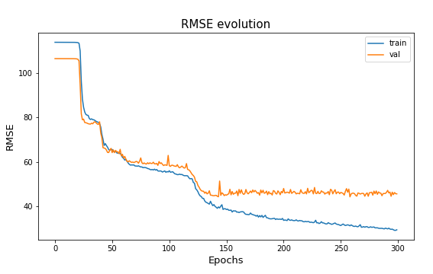
Development of DeepSF2hidden with gene expression
2) SELECT THE NUMBER OF HIDDEN LAYERS, THE LOSS FUNCTION AND TRYING DIFFERENT PIPELINES TO COUNTERACT VARIABILITY IN ISOFORM EXPRESSION.
Model | RMSE values
2 HL with label transformation | 0.42
Mean imputation of the features with label transformation | 0.46
Median imputation of the features with label transformation | 0.48
2 HL model without label transformation but with weighted loss | 50.30
2 HL model without label transformation | 50.86
3 HL model without label transformation | 51.95
Mean imputation of features without label transformation | 116.76
Median imputation of features without label transformation | 120.72
Results – Adding a 3rd hidden layer
Makes the model to converge faster
Without having introduced any regularization method, the model suffered from further overfitting. Losing the model’s ability to generalize.
The results obtained do not justify introducing additional layers to the 2 hidden model.
Model error vs the error committed by using the mean and median of transcripts using RMSE.
2 HL model
3 HL model

Slide 31
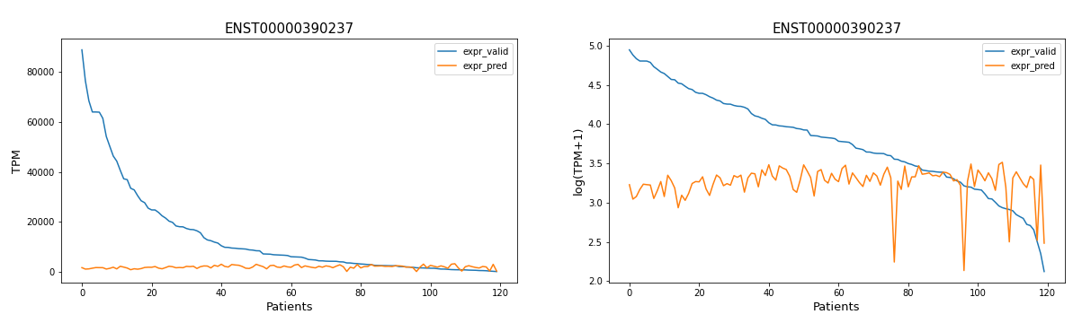
Development of DeepSF2hidden with gene expression
2) SELECT THE NUMBER OF HIDDEN LAYERS, THE LOSS FUNCTION AND TRYING DIFFERENT PIPELINES TO COUNTERACT VARIABILITY IN ISOFORM EXPRESSION.
Results – Defining MAE as loss function
The model error is greater than the error committed when performing the median of the transcript expression.
It predicts expression levels close to zero when dealing with isoforms in which there is high inter-patient variability of expression.
Model | MAE value
2HL without label transformation | 2.65
Mean imputation of the features | 2.86
Median imputation of the features | 2.54
Model error vs the error committed by using the mean and median of transcripts using RMSE.

Slide 32
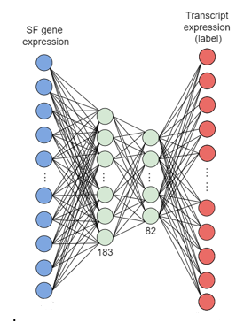


Development of DeepSF2hidden with gene expression
2) SELECT THE NUMBER OF HIDDEN LAYERS, THE LOSS FUNCTION AND TRYING DIFFERENT PIPELINES TO COUNTERACT VARIABILITY IN ISOFORM EXPRESSION.
Conclusions
The 2 hidden layer architecture was maintained.
The use of MAE as loss function was disregarded.
The log2 transformation of the transcript expression was kept as a step of the pipeline.
In view of the poor results obtained using a weighted loss the gene expression of each isoform was introduced in the model.
Notes:
It allows creating models with more complex structures.
Working directly with tensors. Which is very useful for the optimization step.
At this point it was decided to use only certain genes in the modeling. We only tried to predict the isoforms related to cancer genes, which are 10,095.
Introduce additional parameters to the model layers.
We have to define the loss function, the calculation of derivatives and the optimization step.
a trace of the operations performed on them that helps to calculate gradients or derivatives of an output with respect to any of its inputs.

Slide 33
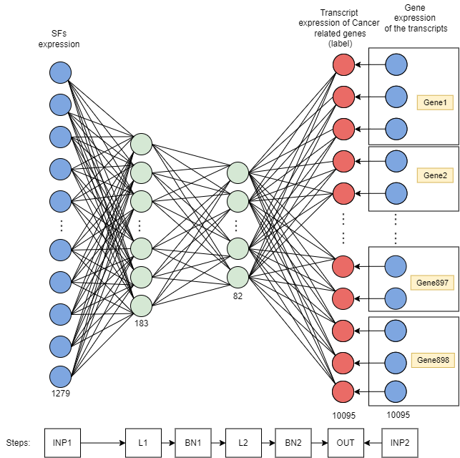
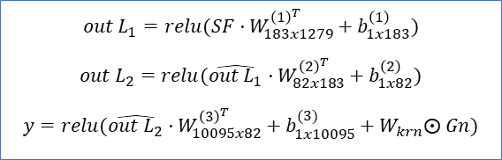
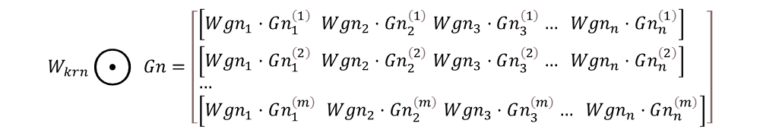
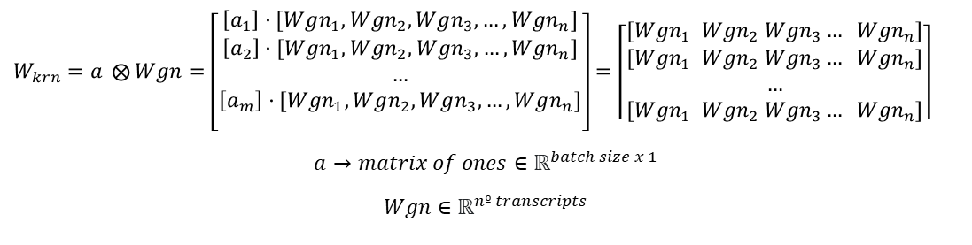
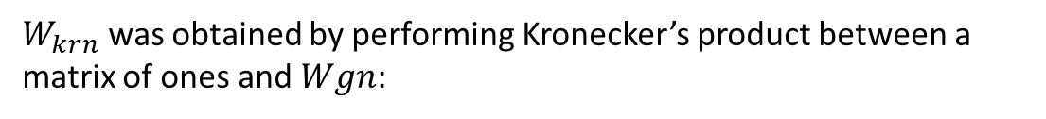
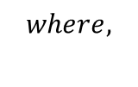

Development of DeepSF2hidden with gene expression
3) ADDING GENE EXPRESSION TO THE MODEL AND STUDY JUST CANCER RELATED GENES
$$out L_{1}=relu(SF·W_{183x1279}^{{\left(1\right)}^{T}}+b_{1x183}^{\left(1\right)})$$
$$out L_{2}=relu(\hat{out L_{1}}·W_{82x183}^{{\left(2\right)}^{T}}+b_{1x82}^{\left(2\right)})$$
$$y=relu(\hat{out L_{2}}·W_{10095x82}^{{\left(3\right)}^{T}}+b_{1x10095}^{(3)}+W_{krn}⨀ Gn)$$
$$where,$$
$$SF∈ℝ^{batch size x 1279 (nº features)}$$
$$Gn∈ℝ^{batch size x 10095 (nº transcripts)}$$
$$W_{krn}∈ℝ^{batch size x 10095}$$
$$y∈ℝ^{batch size x 10095}$$
$W_{krn}$ was obtained by performing Kronecker’s product between a matrix of ones and $Wgn$:
$W_{krn}=a ⨂{Wgn}=\left[\begin{aligned}\left[a_{1}\right]·[Wgn_{1}, Wgn_{2}, Wgn_{3},…, Wgn_{n}] \\ \begin{aligned}\left[a_{2}\right]·[Wgn_{1}, Wgn_{2}, Wgn_{3},…, Wgn_{n}] \\ … \\ \left[a_{m}\right]·[Wgn_{1}, Wgn_{2}, Wgn_{3},…, Wgn_{n}] \\ \end{aligned}\end{aligned}\right]=\left[\begin{aligned}[Wgn_{1} Wgn_{2} Wgn_{3}… Wgn_{n}] \\ [Wgn_{1} Wgn_{2} Wgn_{3}… Wgn_{n}] \\ … \\ [Wgn_{1} Wgn_{2} Wgn_{3}… Wgn_{n}]\end{aligned}\right]$
$$a→matrix of ones∈ℝ^{batch size x 1}$$
$$Wgn∈ℝ^{nº transcripts}$$
$$W_{krn}⨀{ }Gn=\left[\begin{aligned}&\left[Wgn_{1}·Gn_{1}^{\left(1\right)} Wgn_{2}·Gn_{2}^{\left(1\right)} Wgn_{3}·Gn_{3}^{\left(1\right)}… Wgn_{n}·Gn_{n}^{\left(1\right)}\right] \\ &\left[Wgn_{1}·Gn_{1}^{\left(2\right)} Wgn_{2}·Gn_{2}^{\left(2\right)} Wgn_{3}·Gn_{3}^{\left(2\right)}… Wgn_{n}·Gn_{n}^{\left(2\right)}\right] \\ &… \\ &\left[Wgn_{1}·Gn_{1}^{\left(m\right)} Wgn_{2}·Gn_{2}^{\left(m\right)} Wgn_{3}·Gn_{3}^{\left(m\right)}… Wgn_{n}·Gn_{n}^{\left(m\right)}\right]\end{aligned}\right]$$
Therefore, the scalar product between gene expression and the weights vector is calculated as follows:
Notes:
The output of a layer results from performing a linear transformation of the signal from the previous layer nodes to which an activation function is passed.
A new parameter was introduced to the Wgn model, the gene expression weights per transcript.
As for the architecture of the model, it has two inputs: the expression of the SFs entered in the input layer and the gene expression of each of the isoforms entered in the last linear layer. In addition, there are 2 hidden layers with 183 and 82 nodes, respectively, and the output layer consists of 10,095 nodes, which are the transcripts related to the cancer we want to predict.

Slide 34



$$out L_{1}=relu(SF·W^{{\left(1\right)}^{T}}+b^{\left(1\right)})$$
$$out L_{2}=relu(\hat{out L_{1}}·W^{{\left(2\right)}^{T}}+b^{\left(2\right)})$$
$$y=relu(\hat{out L_{2}}·W^{{\left(3\right)}^{T}}+b^{(3)}+W_{krn}⨀ Gn)$$
Development of DeepSF2hidden with gene expression
3) ADDING GENE EXPRESSION TO THE MODEL AND STUDY JUST CANCER RELATED GENES
Batch-normalization
Two batch-normalization layers were introduced after L1 and L2.
Reduces the shifting of hidden layers values.
It allows to increase the learning rate.
$$E[x]=\frac{1}{n}\sum_{i=1}^{n}{x_{i}}(batch mean)$$
$$Var\left[x\right]=\frac{1}{n}\sum_{i=1}^{n}{{{(x}_{i}−μ_{ℬ})}^{2}} (batch variance)$$
$$\hat{x}=\frac{x−E[x]}{\sqrt{Var\left[x\right]+ε}} (batch normalization)$$
Notes:
Así como los inputs al modelo son normalizados antes de alimentarlos al modelo se introdujeron 2 capas de batch-normalization tras el L1 y el L2.
Evitando que la activación de los nodos sea muy grande o pequeña.
Lo que acelera el proceso de aprendizaje.
Thus the batch-normalization layer normalizes the signals coming from previous layer by removing for each node the mean of the batch and dividing it by the standard deviation, so that to have a mean zero and standard deviation of one.
Dicen que puede reducir el Internal Covariate Shift pero hay un estudio del MIT del 2018 que lo desmiente.

Slide 35

Development of DeepSF2hidden with gene expression
4) BEST OPTIMIZER SELECTION USING A PYTORCH MODEL
The model performance was compared by:
- MSE loss in the validation set.
- Spearman’s correlation between predicted and theoretical values.
The training configuration was the following one:
Settings | Value
Nº of epochs | 3000
Learning Rate | 0.001
Cancer Type | LUAD
Test Size | 0.2
Number of Genes | 898 (Cancer related genes)
Batch size | 32
Loss function | MSE
Training configuration
Notes:
Spearman's correlation method studies the relationship between two sets of data. It does not assume that the data are normally distributed and the values of the coefficients vary between -1 and 1, where a value of 1 means a positive exact monotonic relationship and a value of -1 means a negative exact monotonic crelationship. A value of 0 means that there is no relationship between the two data compared.
In addition, the correlation for each transcript and each biotype was also plotted for the training set and the validation set.

Slide 36






Development of DeepSF2hidden with gene expression
https://wandb.ai/deepsf/DeepSF_optimizers_run?workspace=user-jsanchoo
4) BEST OPTIMIZER SELECTION USING A PYTORCH MODEL
N=7829
N=7610
Model | Sample size | Correlation
DeepSF2hidden with AdamW | $$n=4286$$ | $$mean$$ | 0.73
 |  | $$median$$ | 0.80
Model | Sample size | Correlation
DeepSF2hidden with AdamW | $$n=4173$$ | $$mean$$ | 0.61
 |  | $$median$$ | 0.67
Results
The best results were obtained with AdamW and Adam.
Convergence was not achived with most of the optimizers.
Optimizer | Total Correlation Training | Total Correlation Validation | Training Loss | Validation Loss
AdamW | 0.8872 | 0.8495 | 0.0733 | 0.1739
Adam | 0.8830 | 0.8460 | 0.0748 | 0.1893
AdaGrad | 0.8153 | 0.7883 | 0.2421 | 0.3849
SGD90 | 0.6726 | 0.6533 | 0.5373 | 0.6841
SGD70 | 0.4712 | 0.4382 | 0.9824 | 1.1760
SGD50 | 0.2773 | 0.2508 | 1.8420 | 2.0460
Adadelta | 0.1152 | 0.1039 | 2.4560 | 2.5660
ASGD | 0.1028 | 0.0920 | 2.4860 | 2.5910
Results obtained in the correlation and MSE loss with training and validation using different optimizers
Training data
Validation data
Notes:
In Adam and AdamW the decrease of the loss function curve has been too pronounced, practically reaching convergence in the first epochs, which is not entirely desirable. Therefore, it would be interesting to use a lower learning rate in the following runs.
It is also interesting to mention that the higher the momentum applied in the SGD, i.e. the more we take into account past updates, the better results are obtained and the faster the loss function curve goes down.
Despite the fact that, as mentioned above, there is a high correlation between the values predicted by the model and the theoretical values, there is some presence of outliers, especially in the validation set.
The rest have turned out to be unassigned values because the Spearman correlation is not defined when the standard deviation of one of the sets is 0, which could have occurred for isoforms with expression levels close to 0.
For the TEC (To be Experimentally Confirmed) biotype, which has a correlation very close to 1 in training and around 0.8 in validation, we only have 2 samples in our dataset.

Slide 37
Development of DeepAE: training an autoencoder from different adenocarnima samples
In (Sanjiv K. Dwivedi, 2020) discovered disease-relevant gene modules by training a DeepAE from transcript data.
An AE is a type of NN used to capture the most relevant information from the input data.
Some hidden layers are placed between the input and the output layers to obtain a lower dimensional representation of the input.
Our goal: Identifying the expression characteristics of each tumor type from protein-coding gene expression.
Notes:
In an AE the input data and the output data to be predicted are the same. It is an unsupervised learning method.
Some hidden layers are placed between the input and the output layers to obtain a lower dimensional representation of the input.
We use the architecture and several of the preprocessing and training setup processes presented in the paper.
https://www.v7labs.com/blog/autoencoders-guide#:~:text=An%20autoencoder%20is%20an%20unsupervised,even%20generation%20of%20image%20data.

Slide 38



Development of DeepAE
$$PCGn∈ℝ^{batch x 19594 (nº features)}$$
$$W^{(1)}∈ℝ^{512 x 19594 (nº features)}$$
$$W^{(2)},W^{(3)}∈ℝ^{512 x 512}$$
$$b^{\left(1\right)}, b^{\left(2\right)},b^{\left(3\right)}∈ℝ^{1 x 512}$$
$$W^{(4)}∈ℝ^{19594 (nº features) x 512}$$
$$b^{\left(4\right)}∈ℝ^{1 x 19594 (nº features)}$$
$$y_{PCGns}∈ℝ^{batch x 19594 (nº features)}$$
$$out L_{1}=sigmoid(PCGn·W^{{\left(1\right)}^{T}}+b^{\left(1\right)})$$
$$out L_{2}=sigmoid(\hat{out L_{1}}·W^{{\left(2\right)}^{T}}+b^{\left(2\right)})$$
$$out L_{3}=sigmoid(\hat{out L_{2}}·W^{{\left(3\right)}^{T}}+b^{\left(3\right)})$$
$$y_{PCGns}=sigmoid(out L_{3}·W^{{\left(4\right)}^{T}}+b^{(4)})$$
$$where,$$
Training configuration:
Settings | Value
Epochs | 1000
Learning Rate | 0.0001
Cancer Type | 7 different adenocarcinomas
Test Size | 0.2
Loss function | MSE
Number of Genes | 19594
Batch size | 256
Optimizer | Adam
Beta 1 | 0.9
Beta 2 | 0.999
Epsilon | 1·10⁻⁸
Weight decay | 1·10⁻⁶
The trained model with its weights was saved in wandb.
Notes:
Where we applied the learning rate, the batch size, the optimizer and its hyperparameters that were utilized in [paper].
Paper que ha hecho:
- Normalize by the upper quantile method
https://cmdlinetips.com/2020/06/computing-quantile-normalization-in-python/
- Transformation log2(1+normalized)
- MinMaxScaler -> values between zero and unit
paper run]: input num genes = 20848

Slide 39



https://wandb.ai/fcarazo/Training_DeepAE/runs/32y44uvf?workspace=user-jsanchoo
Development of DeepAE
Results
Model | Training MSE Loss | Validation MSE Loss
DeepAE | 0.0066 | 0.0071
Notes:
About the evolution of the loss function we see a very sharp decrease in the first epochs, but then the curve stabilizes and the learning becomes very slow for the remaining 800 epochs.
As for the evolution of the gradients during training, it can be observed that for linear layers 1 and 2 the variance increases during training (the gradient diverges), which is not convenient. This phenomenon causes the update step of the parameters to continue increasing, which can cause instability in the neural network.
However, in linear layers 3 and 4 the gradients do converge, coinciding especially with the phase in which the loss in training is reduced the most. This is important since the output of linear layer 3 will be the one connected to the final model and the appearance of divergent gradients also in these layers could cause poor prediction results in the ensemble model.

Slide 40






Development of deepSF&AEensemble
$$out AE_{L_{1}}=sigmoid(PCGn·W^{{\left(AE_{1}\right)}^{T}}+b^{\left(AE_{1}\right)})$$
$$out AE_{L_{2}}=sigmoid(\hat{out L_{1}}·W^{{\left(AE_{2}\right)}^{T}}+b^{\left(AE_{2}\right)})$$
$$out AE_{L_{3}}=sigmoid(\hat{out L_{2}}·W^{{\left(AE_{3}\right)}^{T}}+b^{\left(AE_{3}\right)})$$
$$out L_{1}=relu(SF·W^{{\left(1\right)}^{T}}+b^{\left(1\right)})$$
$$out L_{2}=relu(\hat{out L_{1}}·W^{{\left(2\right)}^{T}}+b^{\left(2\right)})$$
$$where,$$
$$W^{(3)}∈ℝ^{10095 x 82+512}$$
$$y∈ℝ^{batch size x 10095}$$
MSE and the Spearman's correlation in the validation data were used to evaluate model performance.
Training setup:
Notes:
Where ⨁ is the concatenation of both matrices and ⨀ is the dot product.
MSE and the Spearman's correlation in the validation data were used to evaluate model performance.
Training setup:

Slide 41




Optimizer | Total Correlation Training | Total Correlation Validation | Training Loss | Validation Loss
AdamW | 0.8872 | 0.8495 | 0.0733 | 0.1739
Adam | 0.8830 | 0.8460 | 0.0748 | 0.1893
AdaGrad | 0.8153 | 0.7883 | 0.2421 | 0.3849
SGD90 | 0.6726 | 0.6533 | 0.5373 | 0.6841
SGD70 | 0.4712 | 0.4382 | 0.9824 | 1.1760
SGD50 | 0.2773 | 0.2508 | 1.8420 | 2.0460
Adadelta | 0.1152 | 0.1039 | 2.4560 | 2.5660
ASGD | 0.1028 | 0.0920 | 2.4860 | 2.5910
Development of deepSF&AEensemble
Results
Optimizer | Correlation Total Training | Correlation Total Validation | Training Loss | Validation Loss
AdamW | 0.8662 | 0.8470 | 0.09878 | 0.2293
Notes:
it can be seen that the total correlation in the validation data has been slightly lower and the error higher.
The latter could be explained, among other things, by the larger number of samples used from different tissues to train the model.
It can be observed that the learning curve drops sharply in the first 200 epochs (despite having reduced the learning rate in this step to avoid it) and then remains mainly stable, reducing the error in the validation and training set slowly.
It is only surpassed in these statistics by the DeepSF2hidden model optimized with the AdamW algorithm. Although there is a presence of certain large outliers.
Enseñar los parametros del autoencoder que no han cambiado porque congelamos esos pesos.

Slide 42




Development of deepSF&AEensemble
Results
N=7060
N=7060
N=7829
N=8313
N=7060
N=8313
N=7060
N=7610
https://wandb.ai/deepsf/DeepSF_AE_Ensemble_training/runs/6ca2brzk?workspace=user-jsanchoo
Notes:
As for the correlation per individual transcript, this model has managed to increase the number of protein-coding genes for which correlation values have been calculated. It went from 7829 transcripts (4286 of them protein-coding genes) in the training data to 8313 (and 4657 protein-coding genes).In the validation set, on the other hand, we went from 7610 transcripts (and 4173 of them protein-coding genes) to 8433 (4720 protein-coding genes).
For this reason, in order to compare the correlation of the DeepSF2hidden with gene expression model and the DeepSF&AEensemble model using the same protein-coding genes, the intersection of the transcripts correlated in the training set and validation set of both models was plotted by biotype, giving a total of 7060 transcripts (and 3912 protein-coding genes).

Slide 43



Interpretation of Model Parameters using Deep Learning Importante Features (DeepLIFT)
DeepLIFT score calculation
We tried to identify the SFs that regulate the gene expression using DeepLIFT.
To calculate the contribution of the SFs to each model output:
Validation set with the gene expression of the SFs.
Median expression of the SFs (baseline).
Additional arguments to peform the forward step.
Result: DeepLIFT scores of size $1279 x 10095 (\#SFs x \#isoforms)$
Notes:
For this purpose, the Deep Learning of Features (DeepLIFT) algorithm was applied to the Deep2hidden with gene expression model, which was optimized with AdamW and trained with LUAD samples.
Where the contribution can be positive or negative depending if the increase of the SF expression leads to a increase or a decrease of the isoform expression, .
Since DeepLIFT requires reference values to compare with to calculate the weight-scores, the selection of a suitable baseline is the key to see the effect we want to discover. In this case, the median expression of the SFs was used as the baseline.
additional arguments needed to run the forward step of the model, but from which we do not want to obtain the contributions. Formed by the validation set of the expression of the genes.
since we developed an output layer with 10095 nodes, the SF scores for each isoform were computed by changing the target index at each iteration. And the stored in a data frame of size $1279 x 10095 (\#SFs x \#isoforms)$

Slide 44



Interpretation of Model Parameters using Deep Learning Importante Features (DeepLIFT)
Comparation between DeepLIFT scores and Theoretical Values
Results:
Optimal threshold: 0.0022
Difference: 2

Slide 45





Interpretation of Model Parameters using Deep Learning Importante Features (DeepLIFT)
Comparation between DeepLIFT scores and Theoretical Values
It was created a general confusion matrix, with the prediction results of all SFs, and a particular confusión matrix for each of the SFs
Results
Only the 30% of SF-Gene regulation relationships (12349 out of 39861) were correctly predicted.
The model can predict the 74.2% of the non-SF-gene interactions.
Notes:
Thus, both a general confusion matrix, with the prediction results of all SFs, and a particular confusion matrix for each of the SFs were performed to evaluate their individual performance in predicting gene regulation.
Performing a confusion matrix is very useful to visualize many performance parameters as:
accuracy, which studies the examples correctly classified over the total number of samples.
sensitivity, that is the true positive rate.
specificity, that is the true negative rate.
As well as other metrics that derived from these such as F1 score and recall.
Below a confusion matrix is presented. Where the rows refer to the theoretical values and the columns to the values predicted by our binary matrix. Also, $SF_{positive}$ means that a corresponding SF regulates a gene and $SF_{negative}$that it does not.
Where TN refers to the negative examples and TP indicates the number of true regulations that our model has been able to identify. While FN are the samples that we have predicted as negative but the regulation actually exists and FP are the negative samples that we have predicted as positive. The above metrics can be calculated from these four values.
The value of the precision-recall metric makes us see this problem of the model to distinguish when a SF-gene regulation appears.
On the other hand, with CPSF3, the 74.72% of the regulations have been identified, but suffering from a reduction in accuracy.

Slide 46
5. CONCLUSIONS

Slide 47





Conclusions
It was succesfully developed a DNN model capable of predicting:
Regarding the model architecture, data processing and training configuration:
Performance results:
$$MSE=\frac{1}{n}\sum_{i=1}^{n}{{\left(y_{i}−\hat{y_{i}}\right)}^{2}}$$
Settings | Value
Nº of epochs | 3000
Learning Rate | 0.001
Cancer Type | LUAD
Test Size | 0.2
Number of Genes | 898 (Cancer related genes)
Batch size | 32
Loss function | MSE
Optimizer | Total Correlation Training | Total Correlation Validation | Training Loss | Validation Loss
AdamW | 0.8872 | 0.8495 | 0.0733 | 0.1739

Slide 48
Conclusions
On the other hand, the cellular context in the prediction of transcript expression was studied by training a DeepAE with different types of adenocarcinomas.
The autoencoder architecture was not optimized. Despite having used a contrated architecture presented in (Sanjiv K. Dwivedi, 2020).
Notes:
The evolution of the gradients for the first layers suggests that we should have introduced a stronger regularization to control the divergence.
However, the last linear layers did manage to converge the value of the gradients as the network learned.

Slide 49

Conclusions
Results in DeepSF&AE vs DeepSF2hidden:
The model with the AE has outperformed the previous model by:
1) increasing the number of protein-coding genes for which we have obtained correlation data and 2) increasing the correlation of protein-coding genes with a fix set of genes in the validation set.
Model | Total Correlation Training | Total Correlation Validation | Training Loss | Validation Loss
DeepSF2hidden | 0.8872 | 0.8495 | 0.0733 | 0.1739
DeepSF&AE | 0.8662 | 0.8470 | 0.09878 | 0.2293
Notes:
The evolution of the gradients for the first layers suggests that we should have introduced a stronger regularization to control the divergence.
However, the last linear layers did manage to converge the value of the gradients as the network learned.
The output of the last hidden layer was connected to the last linear layer of the model with gene expression. Correlation values similar to the DeepSF2hidden model have been obtained but the correlation of the model between the predictions and the theoretical values in the validation set has not been improved. On the other hand, in terms of correlation by biotype using the same set of 7060 transcripts, the mean and median correlation has increased with respect to the previous model for the validation set. From a mean of 0.63 to a 0.7 and from a median of 0.69 to 0.75.

Slide 50
Conclusions
Model interpretability:
Not significant results. Only 30% of the SF-Gene regulatory interactions have been identified.
Among other factors limiting the interpretation just to gene regulation could have been no effective. Since a SF might not regulate all the transcripts of the same gene or positively regulate some and negatively regulate others.
In addition, the model may not have been fully optimized or may not have correctly interpreted the DeepLIFT scores through the choice of the threshold.

Slide 51
6. FUTURE LINES

Slide 52


Future Lines
Optimize the autoencoder architecture and using the gene expression of more biotypes.
Study the SFs-Genes-Transcripts regulatory interaction by training a Graph Neural Networks (GNNs) from the knowledge obtained with the DNN model presented in this project.
Calculate the isoform usage, i.e. the percentage of each isoform expressed in each gene,
0.6
0.1
0.3
Notes:
and make this the variable to be predicted. E.g.: If a gene has two isoforms with 30 and 70 tpms respectively we would have 0.3 and 0.7. If a gene has only one isoform it will always be 1

Slide 53
EXTRA information:

Slide 54


Spearman’s correlation
Spearman's correlation measures how strong the monotonic relationship between two sets of data is. It performs this by ranking the values of each of the variables from lowest to highest and calculates the linear correlation of these rankings by using Pearson's correlation.
Notes:
Biblio:

Slide 55


Activations Functions
A sigmoid function can be used to restrict the results between 0 and 1.
A ReLU function is a linear function that will output the input directly if it is positive, otherwise, it will output zero

Slide 56
Desarrollo del modelo DeepSF2hidden con gene expression
3) Añadir la expression de los genes al modelo con Pytorch y usar solo los genes relacionados con el cancer
Pytorch
Cada modelo desarrollado con Pytorch se definió como una clase de Python que es como un constructor de objetos. Dentro se programaron las siguientes funciones:
def __init__(self, n_inputs, n_outputs): se usa para crear el objeto (modelo) y se indica cuales van a ser las capas del modelo con el número de nodos de entrada y de salida. Aquí se pueden inicializar también otros parámetros.
def forward (self, xb, gb): se unen las diferentes capas del modelo con sus respectivas funciones de activación para generar la predicción del modelo a partir de datos de entrada.
def training_step (self, batch, optimizer): realiza las predicciones para un batch, calcular el error del modelo, los gradientes de los pesos y finalmente los actualiza.
def validation_step (self, batch): calcula el error del modelo para un batch.
Además de funciones para mostrar el error por epoch.
Notes:
Meter esta como adicional.

Slide 57





Loss functions
Es la métrica con la que evaluamos el rendimiento del modelo. Probamos diferentes loss functions para elegir cual se ajustaba mejor a nuestro problema.
MAE da el mismo peso relativo a todos los errores.
MSE penaliza más los errores grandes.
El RMSE aumenta con el aumento de la varianza de la distribución de la frecuencia del error y no necesariamente con el aumento de la varianza del propio error.
Ambos son indiferentes a la dirección del error.
$$MAE=\frac{1}{n}\sum_{i=1}^{n}{\left|y_{i}−\hat{y_{i}}\right|}$$
$$MSE=\frac{1}{n}\sum_{i=1}^{n}{{\left(y_{i}−\hat{y_{i}}\right)}^{2}}$$
$$RMSE=\sqrt{\frac{1}{n}\sum_{i=1}^{n}{{\left(y_{i}−\hat{y_{i}}\right)}^{2}}}$$
Notes:
[biblio] https://medium.com/human-in-a-machine-world/mae-and-rmse-which-metric-is-better-e60ac3bde13d
The MAE measures the average of the absolute difference between the prediction and the theoretical value.
The mean squared error (MSE) is a quadratic function that also calculates the mean magnitude of the error. However, these errors are squared before calculating the average.

